Slide 1

LAM VCC Automation
WWW.GSPANN.COM

Slide 2
Agenda
LAM Automation overview
Automation Framework
  Integration with Jenkins
  Execution Logs
  Execution Summary Logs
Demo
Q & A
WWW.GSPANN.COM

Slide 3






LAM VCC Automation Overview
LAM VCC is a continues development environment and QA responsibility is to make sure any new commits from development team is not affecting to existing functionality/environment of LAM VCC. To achieve this target we have automated sanity test scenarios which are being executed using CI tool (Jenkins) on hourly basis jobs.
Test Automation Tool & Environment
  Selenium 2 (Web Driver) v2.44.0
  TestNG v6.8.8 (Test case management)
  Maven v3.1.0 (Project Object Model)
  CI Tool :- Jenkins (Git SCM)
  Java 1.7
Test Environment :-
  DEV :- https://vcclamresearch.com/SitePages/MyVCC.aspx
  Users:- LAM PM, CST PM, LAM User, CST User
WWW.GSPANN.COM

Slide 4
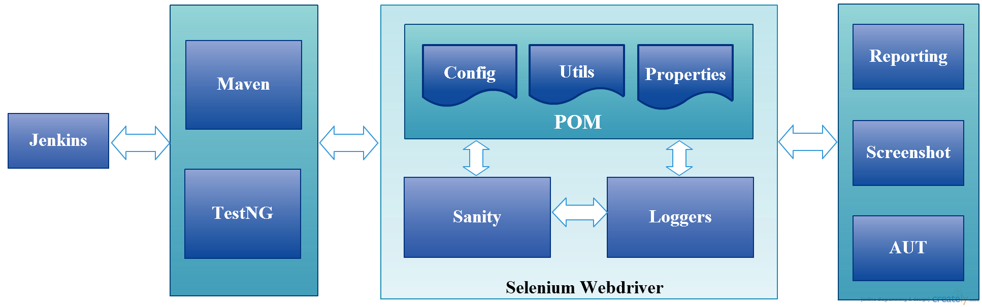
Automation Framework
WWW.GSPANN.COM

Slide 5
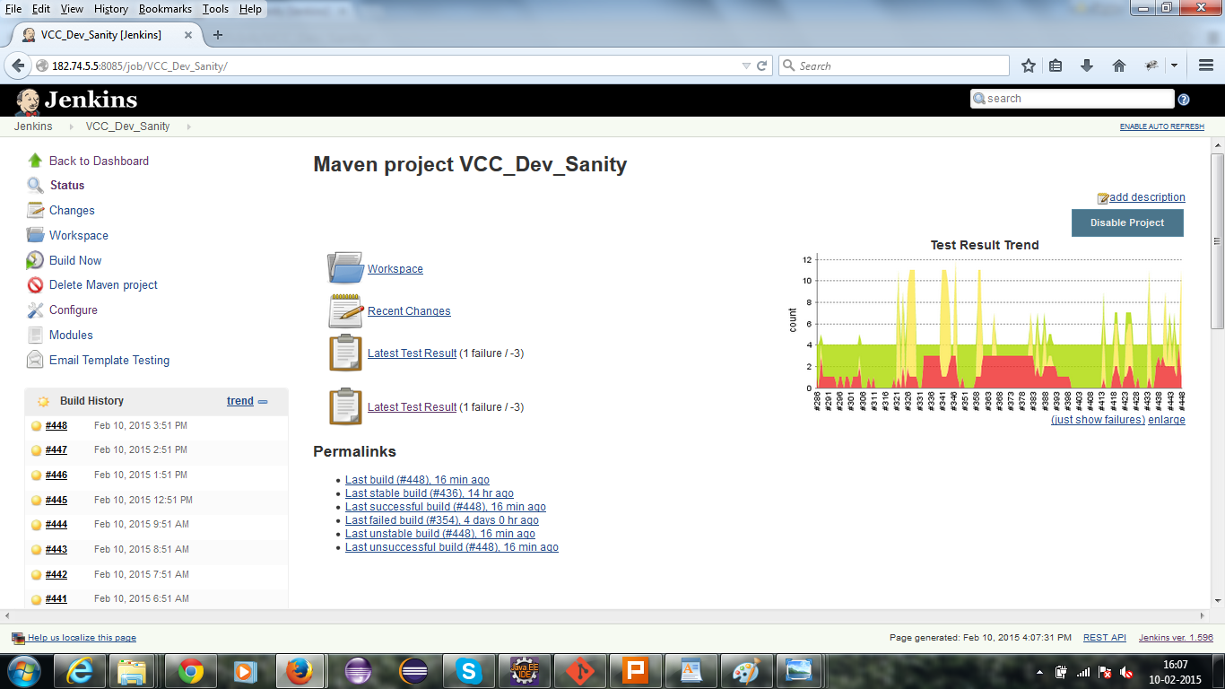
Integration with Jenkins
WWW.GSPANN.COM

Slide 6
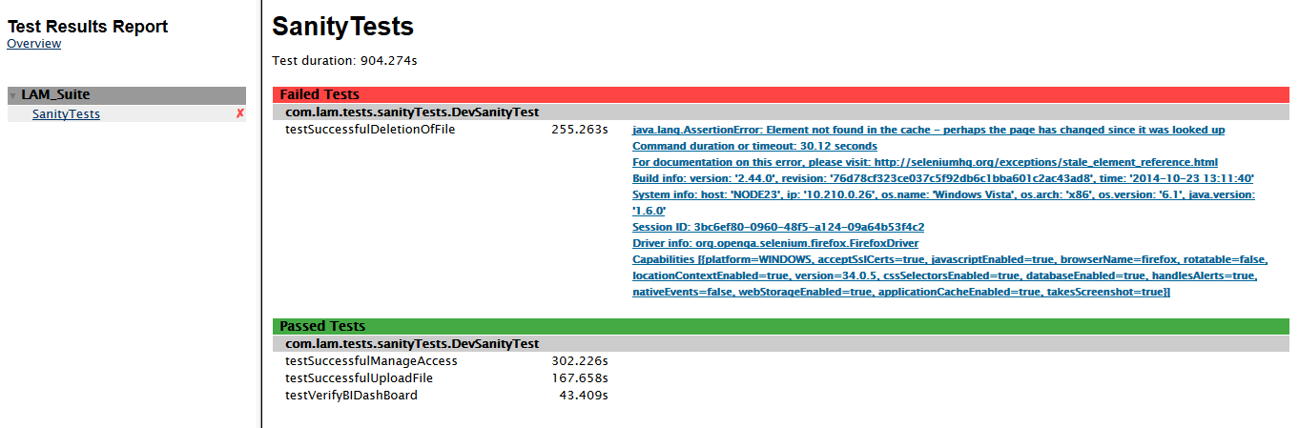
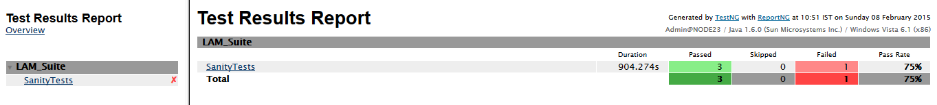
Execution and Summary Logs
Execution Log
Summary Log
WWW.GSPANN.COM

Slide 7

WWW.GSPANN.COM

Slide 8

WWW.GSPANN.COM

Slide 9

WWW.GSPANN.COM

